Slide 1
Building Awareness of STEM and
Non-traditional Energy Career
Pathways among Girls
Presented by the Center for Energy Workforce Development

Slide 2
Today’s webinar is about…
Increasing the diversity of the workforce is on the top of many energy company’s priority lists. The percentage of women in STEM and non-traditional careers tops out at under 15%. So, how do we build a pipeline of female candidates? It starts by creating awareness of these career pathways among girls.

Slide 3
Speakers
Nimisha Ghosh Roy, National Girls Collaborative and FabFems Projects
Joyce Cooper, Omaha Public Power District
Valerie Taylor, CEWD

Slide 4
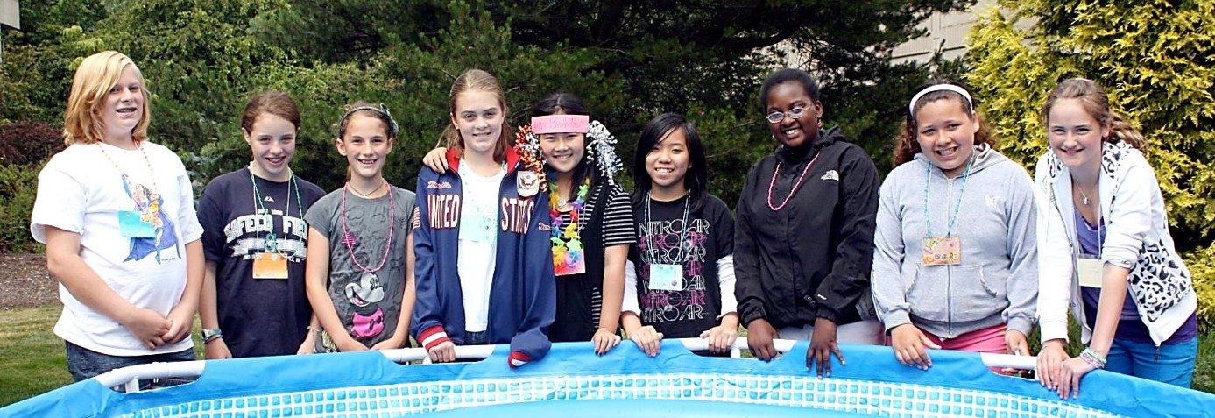
National Girls Collaborative Project & FabFems
Collaboration Opportunities for the
Center for Energy Workforce Development
March 24, 2015

Slide 5
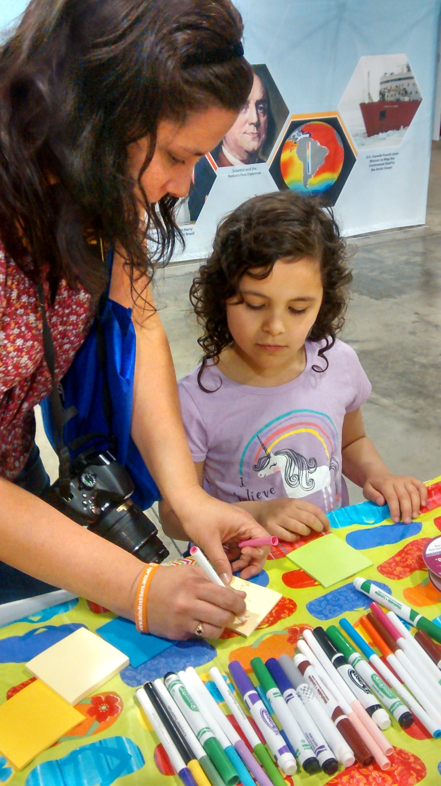
Agenda
NGCP Overview
Resources for Engaging Girls
FabFems Project
Getting Involved

Slide 6
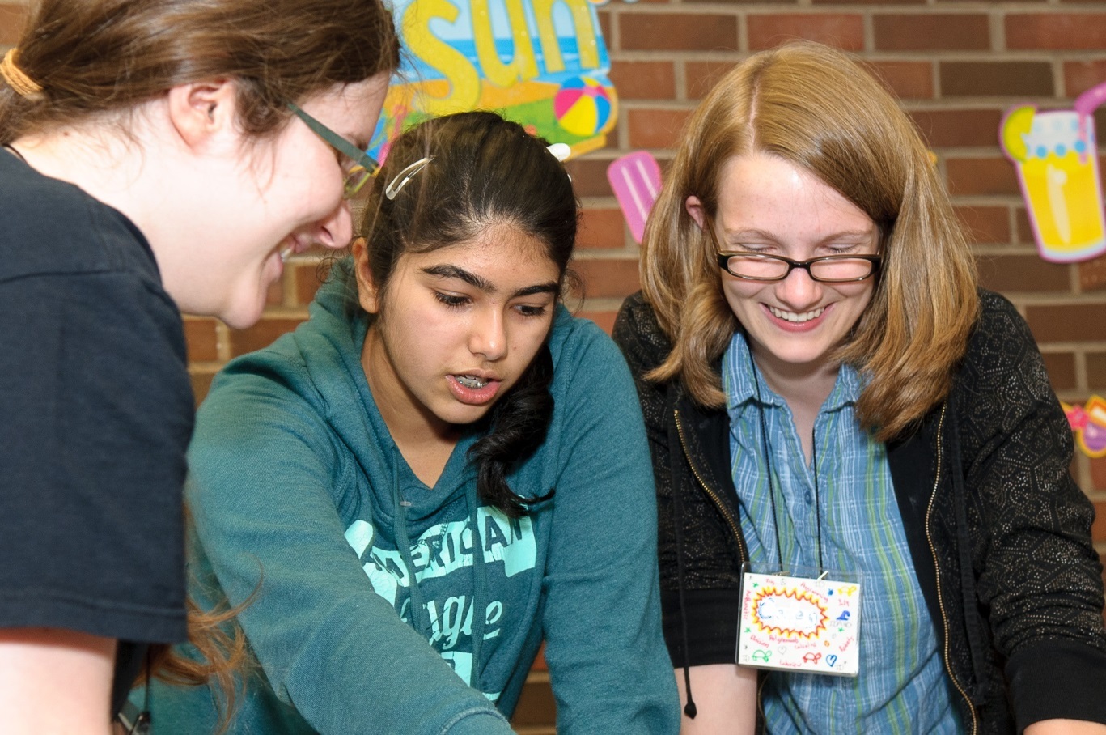
The National Girls Collaborative Project brings together organizations that are committed to informing and encouraging girls to pursue careers in science, technology, engineering, and mathematics (STEM).
www.ngcproject.org

Slide 7
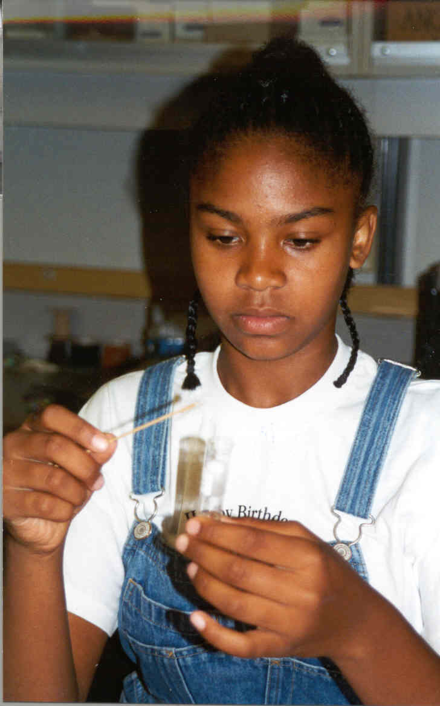
Project Goals
Maximize access to shared resources
Strengthen capacity of existing projects
Collaborate to create the tipping point for gender equity in STEM

Slide 8
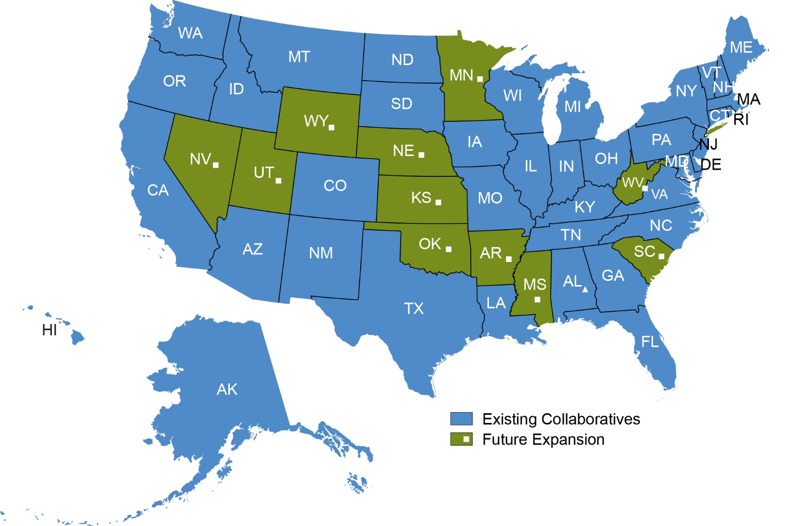
National Network of Collaborative Teams

Slide 9
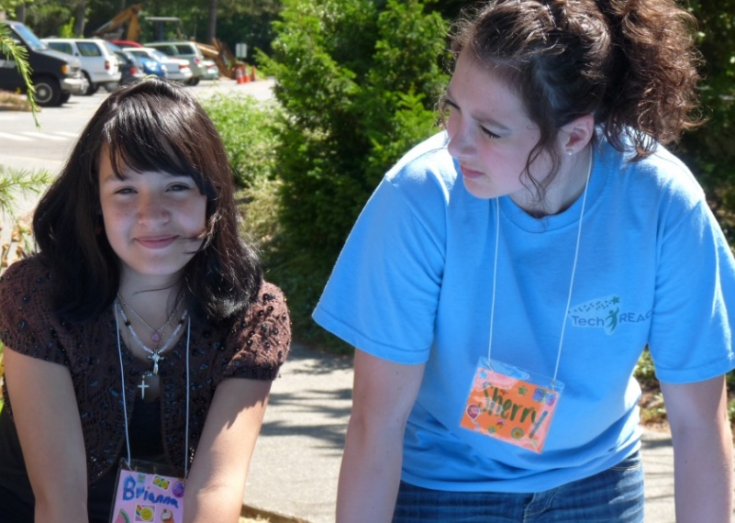
NGCP Project Impact
3,660 programs are listed in the online NGCP Program Directory
33,583 participants served in 236 mini-grants completing activities
45,181,614 visits to the NGCP Web site in 5 years
18,300 practitioners have been served through events and webinars
7,821,024 girls are served indirectly by NGCP by having their leaders trained in the philosophy, knowledge, and methods of NGCP

Slide 10
Why Girls and STEM?
Girls and boys do not display a significant difference in their abilities in math and science.
Differences exist between girls and boys in confidence and interest in STEM.
Women continue to be underrepresented in STEM at college and workforce level, especially in engineering, computer science, and physical sciences
STEM is an equity issue

Slide 11
NGCP Activities
Virtually:
Content Rich Project Website
http://www.ngcproject.org/engaging-girls-stem
NGCP Program Directory
E-Newsletter
Webinars
Collaboratives:
Professional Development:
Conferences and Forums
Incentives to Collaborate: Mini-Grants
Newsletters and Local Resources

Slide 12
NGCP Webinars

Slide 13
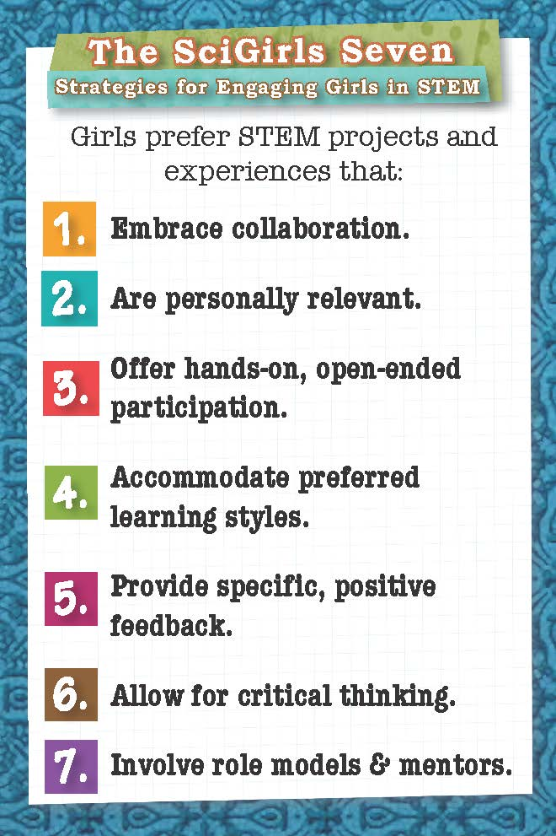
SciGirls Seven
View Episodes Online: http://pbskids.org/scigirls/
Sign Up for Educator Resources: http://www.scigirlsconnect.org

Slide 14
The FabFems Project

Slide 15
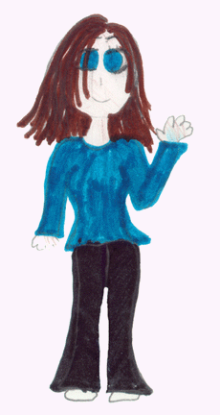
Changing Perceptions About STEM Careers
http://ed.fnal.gov/projects/scientists/index.html

Slide 16
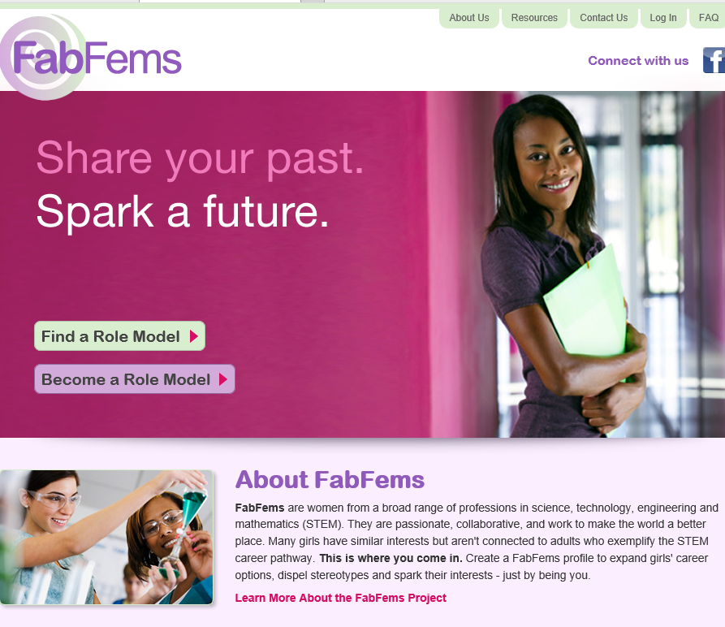
FabFems Website
FabFems is a national, online, searchable directory of women STEM professionals interested in outreach to girls
Audience:
Role Models
Girl-Serving Programs
Parents and Girls
www.fabfems.org

Slide 17
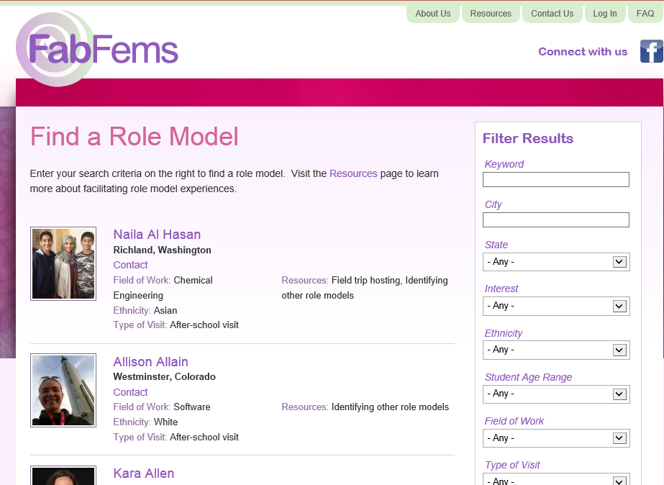
Search for FabFems
Keyword
City
State
Interest
Ethnicity
Student Age
Field of Work
Type of Visit
Affiliations

Slide 18
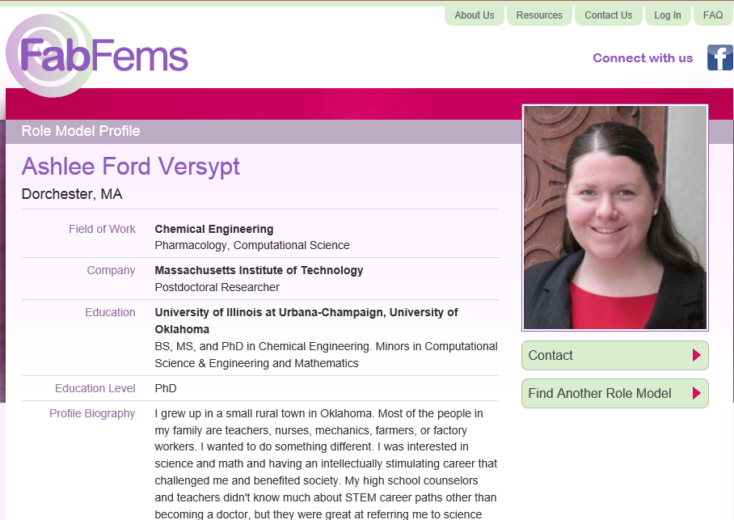
A FabFems Profile

Slide 19
Online Safety: Screening FabFems
Each profile is reviewed by FabFems staff before publishing on the website
All applicants are checked out on the National Sex Offender Registry
All applicants go through an email verification check
All content, including text, images, links and videos are reviewed by FabFems staff for appropriateness before publishing

Slide 20
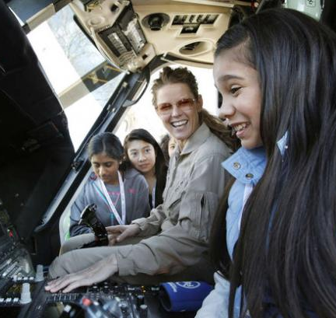
Various Levels of Engagement
Online role model (Email, Skype, Google Hangouts…)
Job shadowing
Field trips
Visits to school, camps, afterschool programs, etc

Slide 21
Activity Resources
www.fabfems.org/resources
Engineer Your Life
Engineer Girl
SciGirls
Techbridge Role Model Toolkit & Guide

Slide 22
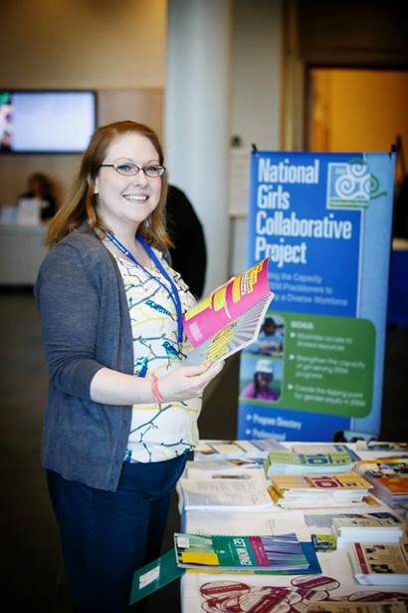
Next Steps!
Join the Program Directory
Connect with your Local Collaborative
Review NGCP Resources
Join, refer and connect with FabFems
Other ideas?
Nimisha Ghosh Roy
nghoshroy@ngcproject.org

Slide 23
By Joyce Cooper
March 24, 2015

Slide 24
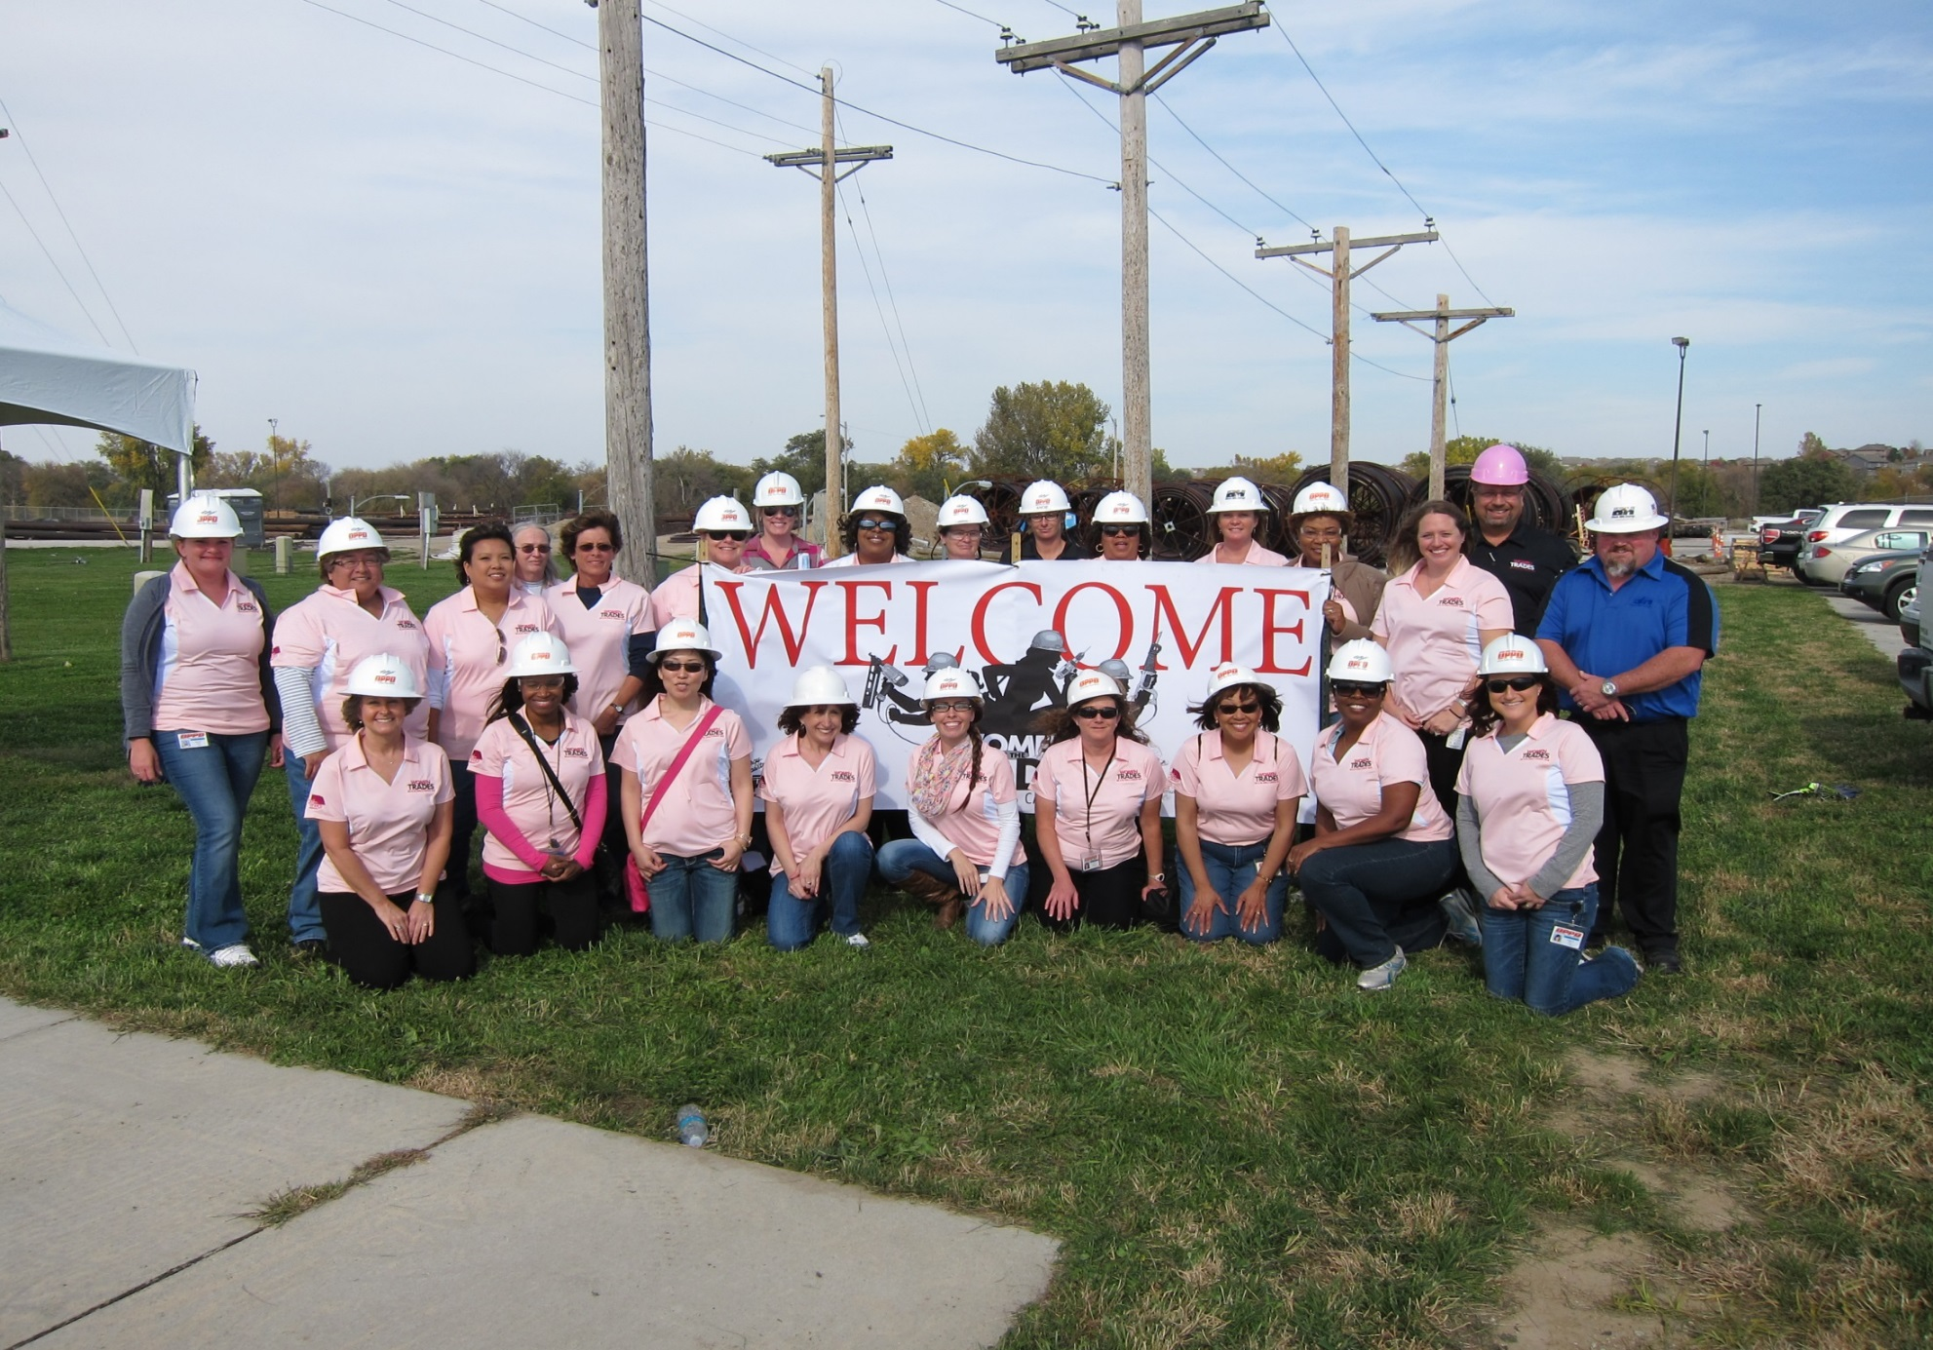

Slide 25
A one-day event for middle and high school girls with the purpose of introducing them to careers in the trades and engineering by: 1. Immersion 2. Engaging 3. Modeling 4. Mapping
What is the Women in the Trades MS & HS Career Fair?

Slide 26
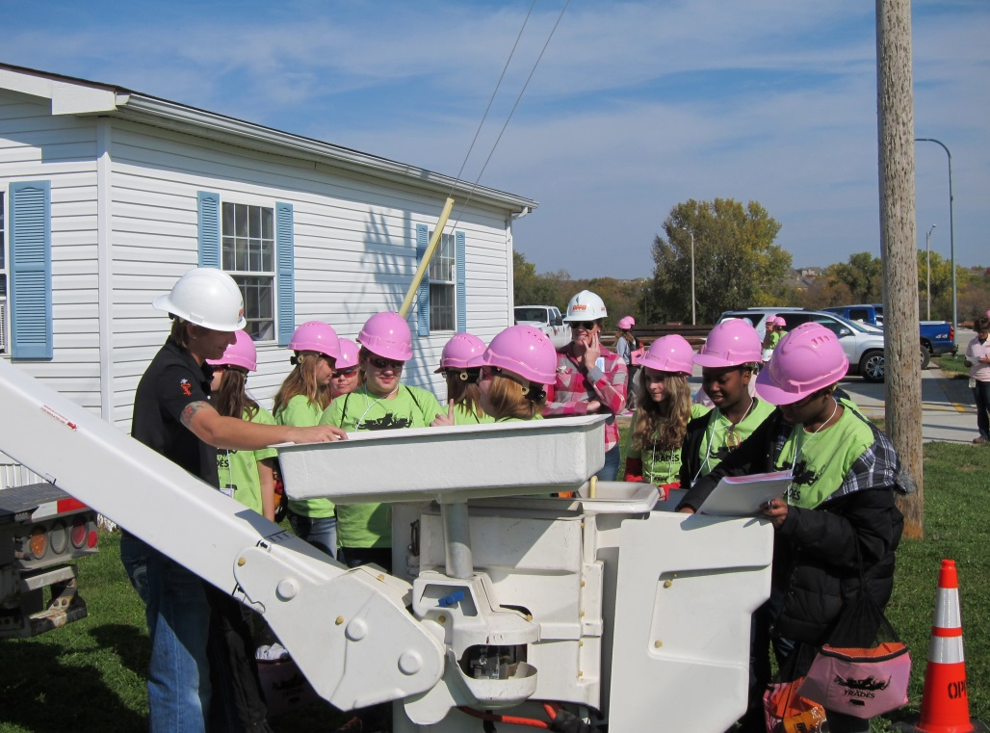
IMMERSION
1. Immerse them in a work environment with professional and skilled trades jobs in the STEM fields
Notes:
1. Immerse them in a work environment with professional and skilled trades jobs in the fields of Science, Technology, Engineering and Mathematics (STEM)

Slide 27
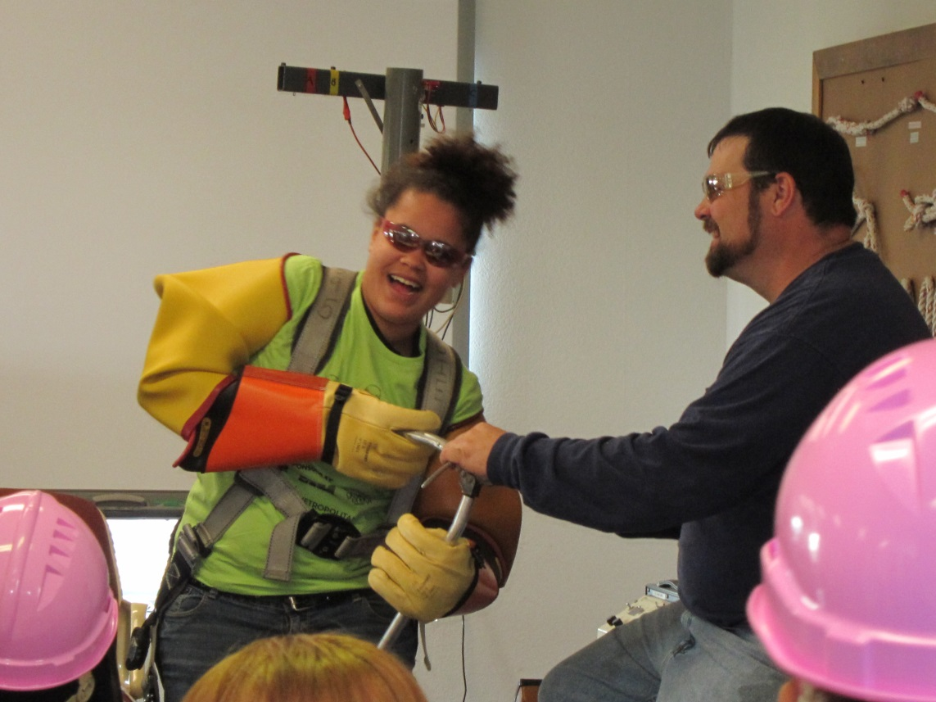
ENGAGING
2. Engage the young women with hands-on activities
Notes:
2. Engage the young women with hands-on activities

Slide 28
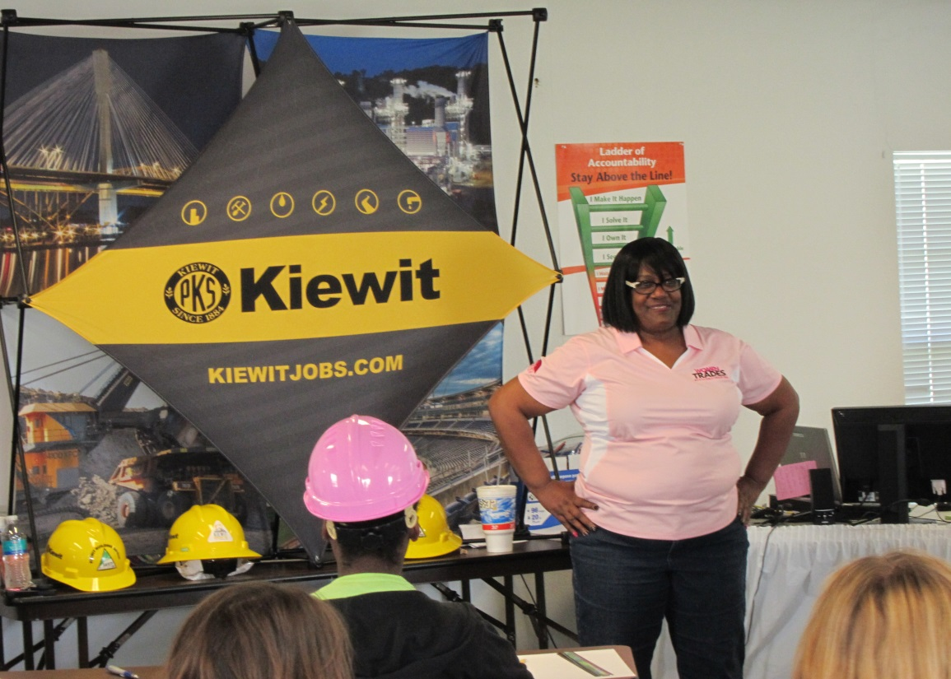
MODELING
3. Providing female role models to
share their experiences in male-dominated environments
Notes:
3. Providing female role models to share their experiences in male-dominated environments

Slide 29
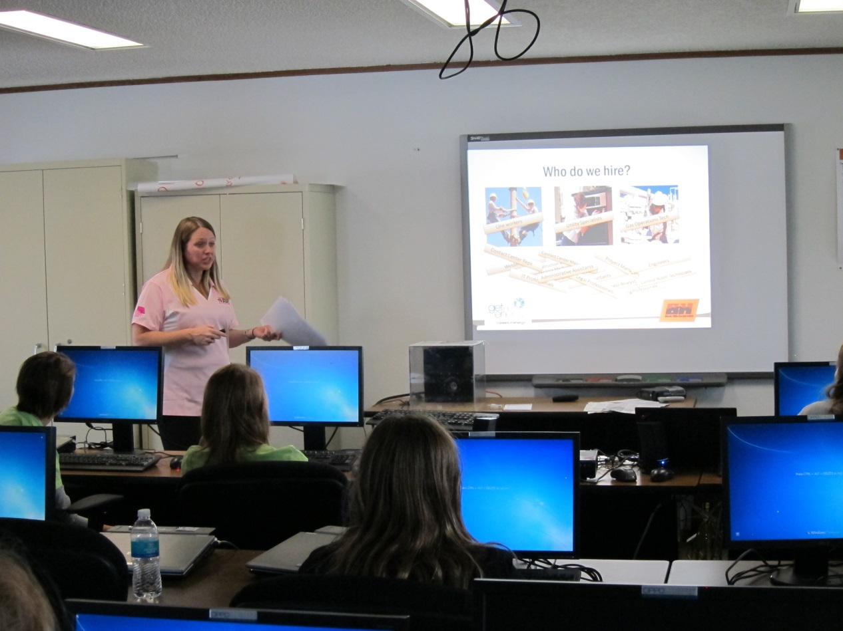
MAPPING
4. Mapping out the education pathways to the skilled trade and professional STEM careers
Notes:
4. Mapping out the education pathways to the skilled trade and professional STEM careers

Slide 30
Why did the NE Energy Consortium decide to pilot the program with CEWD?
High demand for technical talent
70% of the new workers will be females and people of color
STEM graduate numbers are not meeting industry demand
One solution: excite youth about STEM opportunities early in their education.
Notes:
OPPD and BHE, like most electric and gas utilities, are in need of STEM talent to run their businesses
Colleges and universities are not graduating enough STEM graduates to meet industry demand
Research indicates that 70% of the new workforce will be females and people of color
One way to increase females and people of color in the STEM careers is to introduce the STEM opportunities early in their education.

Slide 31
Collaborative Partners
Industry Partners | Education Partners
Black Hills Energy* | Metropolitan Community College
Kiewit | Provided students:
Omaha Public Power District* | Bellevue Public Schools
Supporters: | Boys Town
Center for Workforce Development | Elkhorn Public Schools
Lincoln Electric System* | Omaha Public Schools
Nebraska Public Power District* | Papillion-La Vista Public Schools
 | Partnership 4 Kids
 | Ralston Public Schools
* Nebraska Energy Consortium
Notes:
Use of the Employee Resource Groups- OWN, OSE, YPG

Slide 32
The Agenda
Diesel Transportation
Substation Operations and Engineering
Natural Gas Properties
Line Technician
Bridge Building and Construction
Welding and Measuring
By OPPD
By Kiewit
9:00 a.m. – 2 :00 p.m.
at Elkhorn Service Center
October 22, 2014
By MCC
By OPPD
By OPPD
By BHE
Notes:
79 HS & MS Girls were divided into six groups.
Each group rotated to the six modules

Slide 35
The Impact on the MS Girls

Slide 36
The Impact on the MS & HS Girls

Slide 37
The Impact on the HS Girls

Slide 38
Costs
Item | In-kind | Expense
Shirts | ($1,000.00) | $ 0.00
Back Packs |  | $ 392.60
Hard Hats |  | $ 496.00
Safety Glasses |  | $ 115.00
Lunches |  | $1,357.20
Transportation |  | $202.50
Shirts for adults |  | $3,000.00
Tents, tables, chairs |  | $1,382.00
Porta Potties |  | $ 304.95
Lip gloss, decorations |  | $ 172.40
GIE Handouts, Trades cards, pencils | √ | $ 0.00
Total |  | $7,422.15

Slide 39
What worked?
The six rotations
Having the volunteers stay with one group
The girls feeling valued –
“It’s all about us girls!”

Slide 40
What worked?
Engaged the executives of the companies
Having so many women presenting

Slide 41
What worked?
Having the checklist of tasks
Dividing the checklist tasks into committees
Going on the busses to orient the girls
Student name tags with rotation schedule

Slide 42
What worked?
The ethnic diversity of the volunteers
The large number of volunteers
The lunch procedure
Involving multiple organizations from business and education

Slide 43
What worked?
Literally impacted the girls, broadened their career horizons
The give away items
Everyone was safe

Slide 44
Lessons Learned
Move the Career Fair to September, when the weather is warmer
Allow more time for planning
Make sure that each module has hands-on activities
Notes:
(This was done in 10 weeks)

Slide 45
Lessons Learned
Review each module before they are delivered so adjustments can be made
Have a Command Center with a Project Manager and Assistant to make decisions
Designate team captains for each function

Slide 46
Lessons Learned
Conduct a volunteer orientation and tour the site the day before or before the girls arrive
Place all items for the girls in the backpacks the day before the event
Distribute the final schedules to all of the adults involved

Slide 47
Lessons Learned
Have larger signs and arrows where each module is conducted
Have an Information Technology person available all day

Slide 48
Lessons Learned
Conduct a volunteer orientation and tour the site the day before or before the girls arrive
Place all items for the girls in the backpacks the day before the event
Distribute the final schedules to all of the adults involved

Slide 49
What will be added the next time?
Allot more time to each module
Have girls select 4 out of 6 modules to do
Reserve 2-5 minutes at the end of each module to write in the student handbook

Slide 50
What will be added the next time?
Have a Safety trailer or tent
Provide a profile of each presenter
Hand out certificates of participation

Slide 51
What will be added the next time?
Take a large group photo for a memento
Use Instagram or other social media so the girls can post their pictures and thoughts about their experiences
Send the parents a letter after the day with future opportunities

Slide 52
Plans for the Future
Timeframe | Program
June 2015 | Educators’ Internship at OPPD
July 2015 | STEM Camp for girls at MCC
September 2015 | BHE and OPPD’s Women in the Trades event
Fall 2015 / Spring 2016 | LES and NPPD’s Women in the Trades event
Notes:
June 2015 OPPD will offer an Educators’ Internship
July 2015 OPPD is collaborating with Metropolitan Community College (MCC) to offer a Girls’ STEM camp. The girls who participated in the Career fair will be invited
September 2015 OPPD and Black Hills Energy plan to offer a Women in the Trades once per year in Omaha. Kiewit and MCC expressed interest in continuing to participate in the Omaha Career Fair
LES and NPPD are meeting to determine when they will have Career Fairs in their areas of the State

